Slide 1
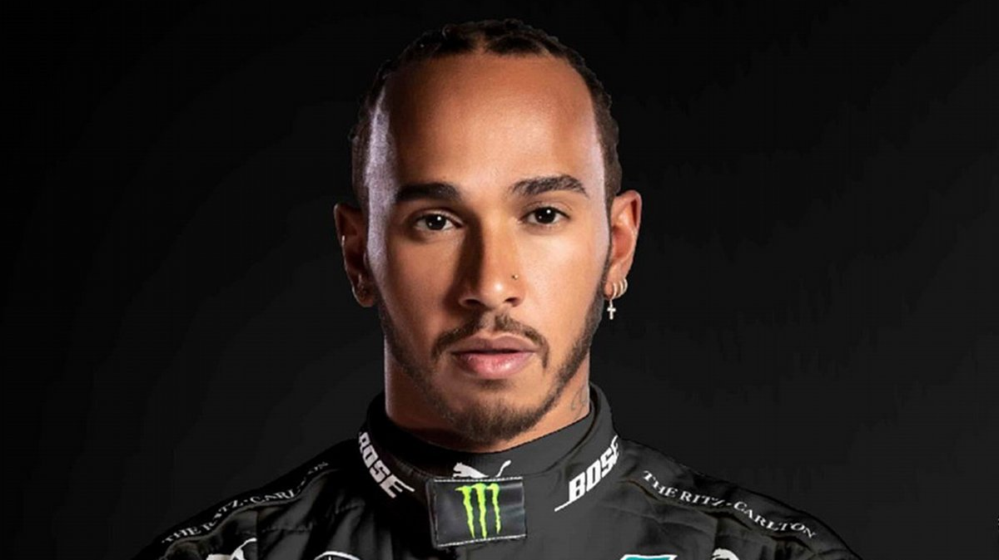
LEWIS HAMILTON
_{Andy BOLAND}
_{Camille LOUIS}
_{Tom IRGEL}
_{Raphaël VASSART}

Slide 2
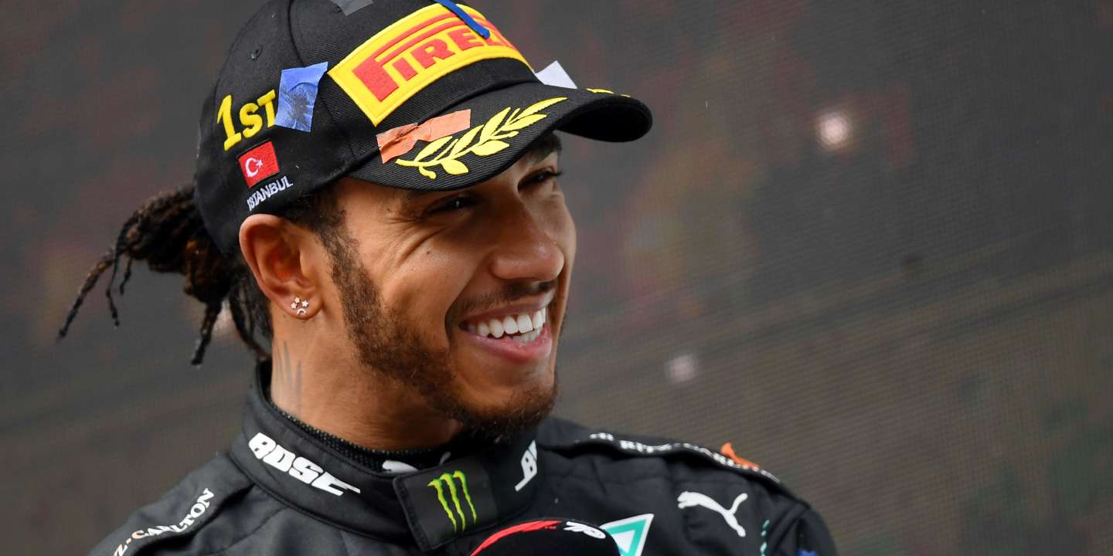



January 7, 1985
January 7, 1985
British racing driver
January 7, 1985
British racing driver
7 times F1 world champion
7 times F1 wo racing driverrld champion
British racing driver
7 times F1 world championJanuary 7, 1985
British racing driver
7 times F1 world champion

Slide 3
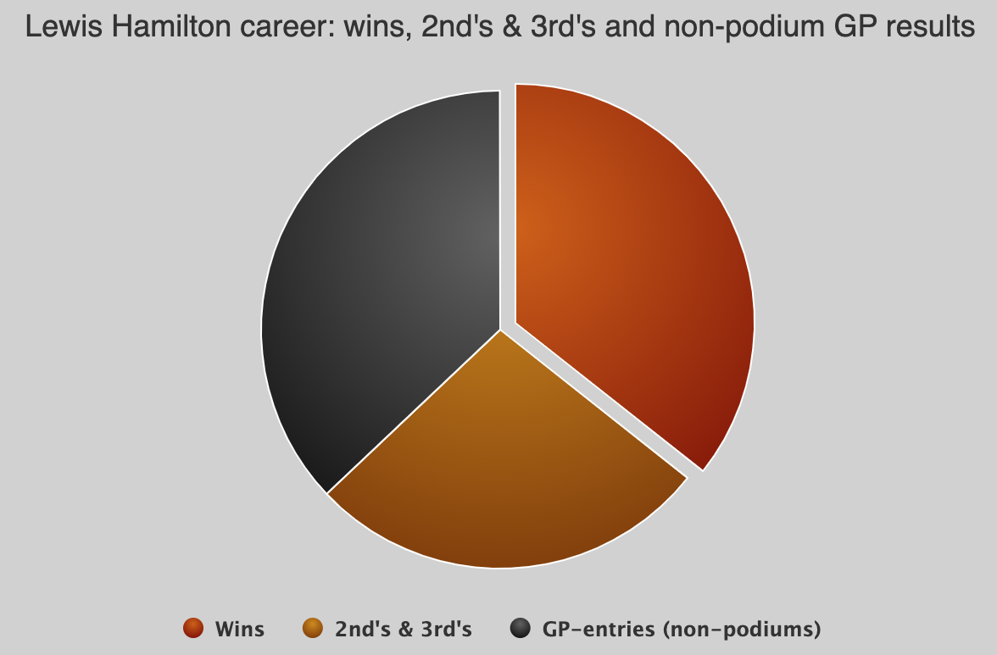


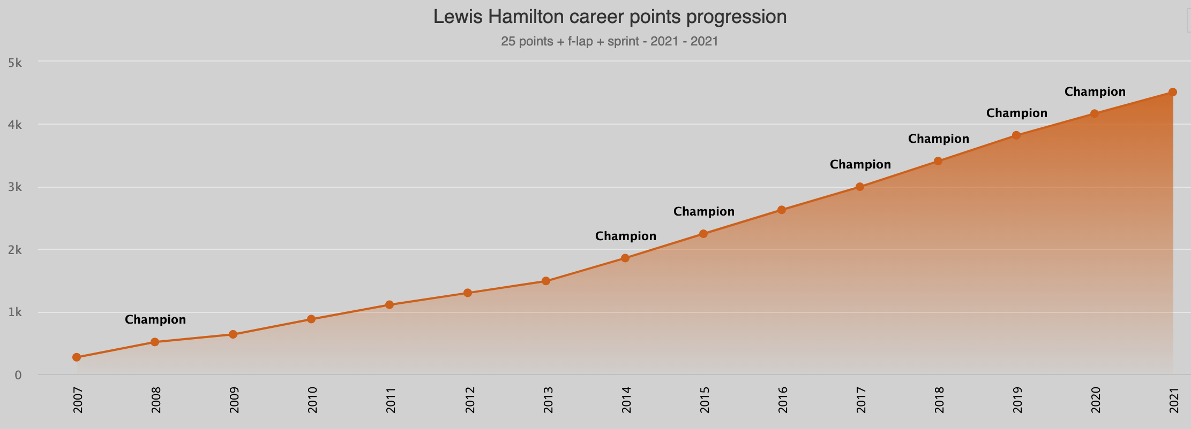

STATS
102 pole positions
180 podiums
102 wins

Slide 4
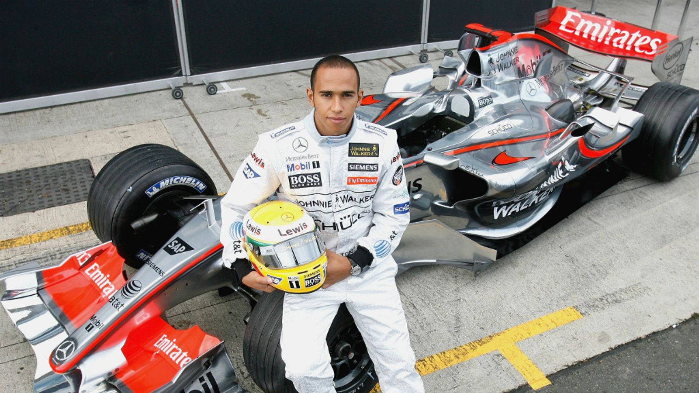
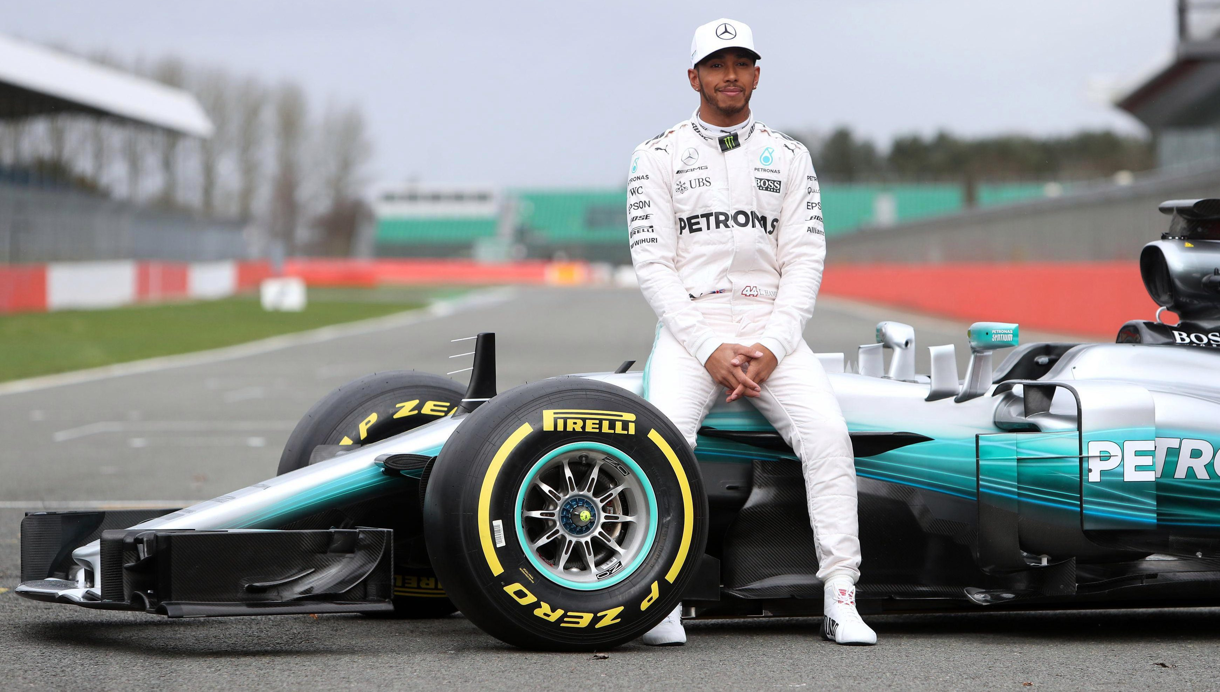
FROM MCLAREN,
6 seasons
21 wins
1 world title
TO MERCEDES,
Since 2013
Turbo-hybrid era
6 world titles

Slide 5
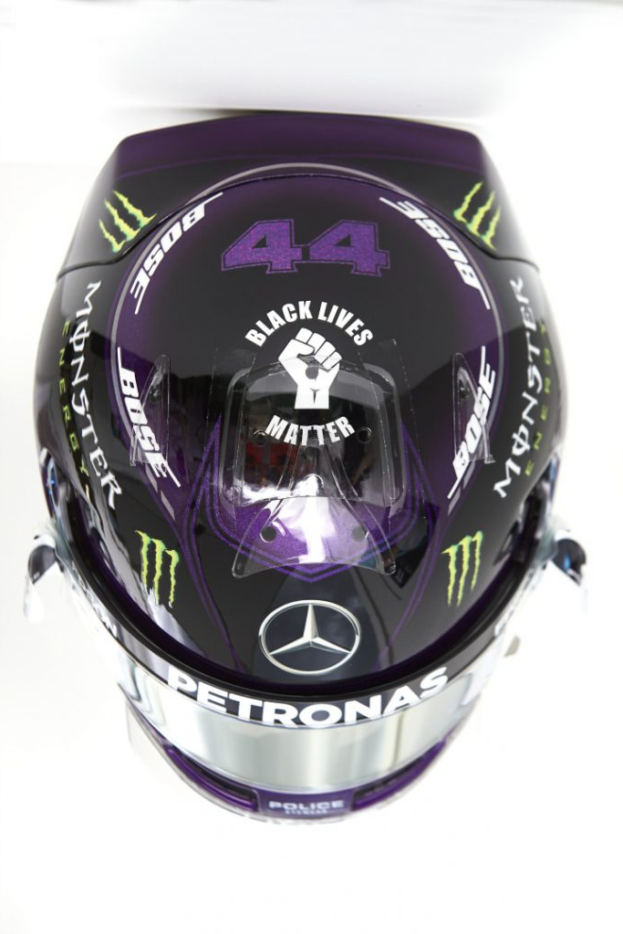
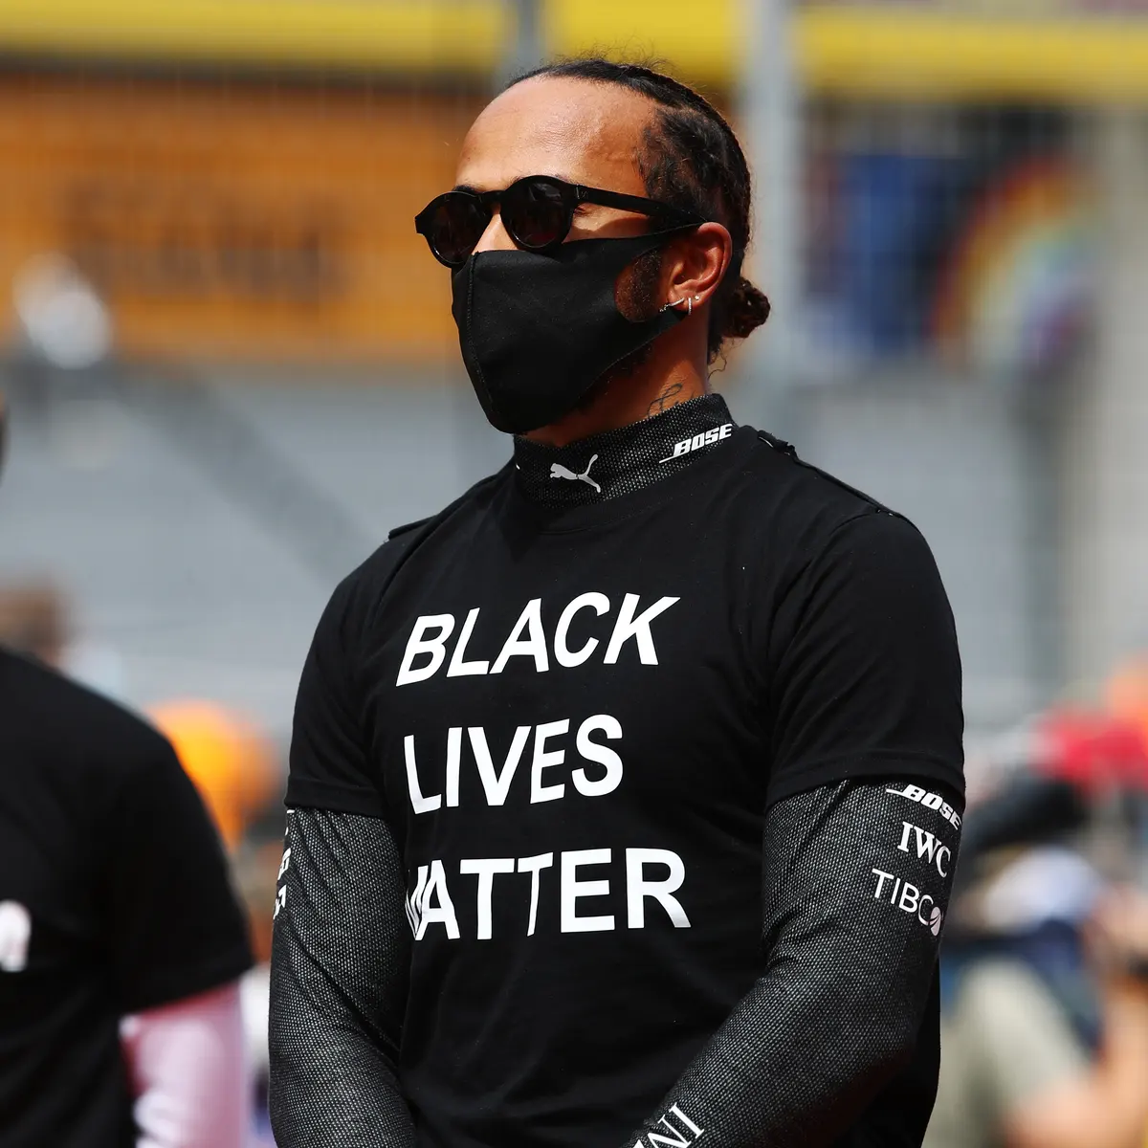
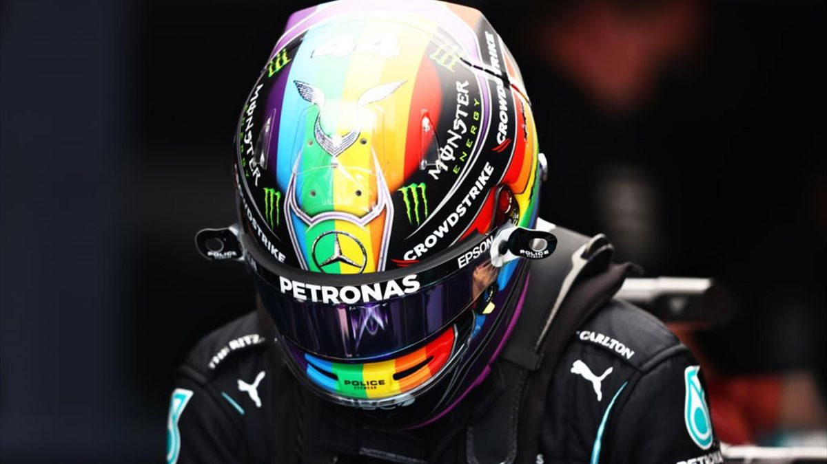
COMMITMENT TO SEVERAL CAUSES

Slide 6
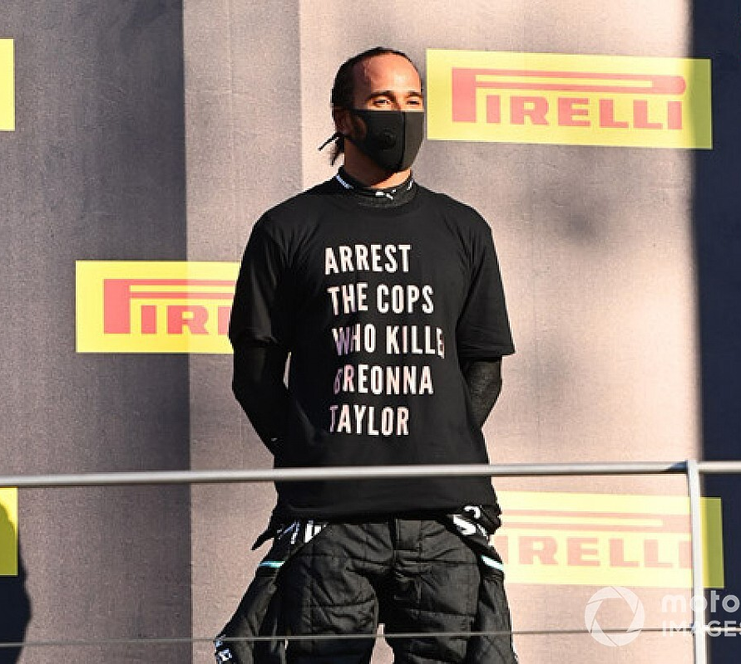
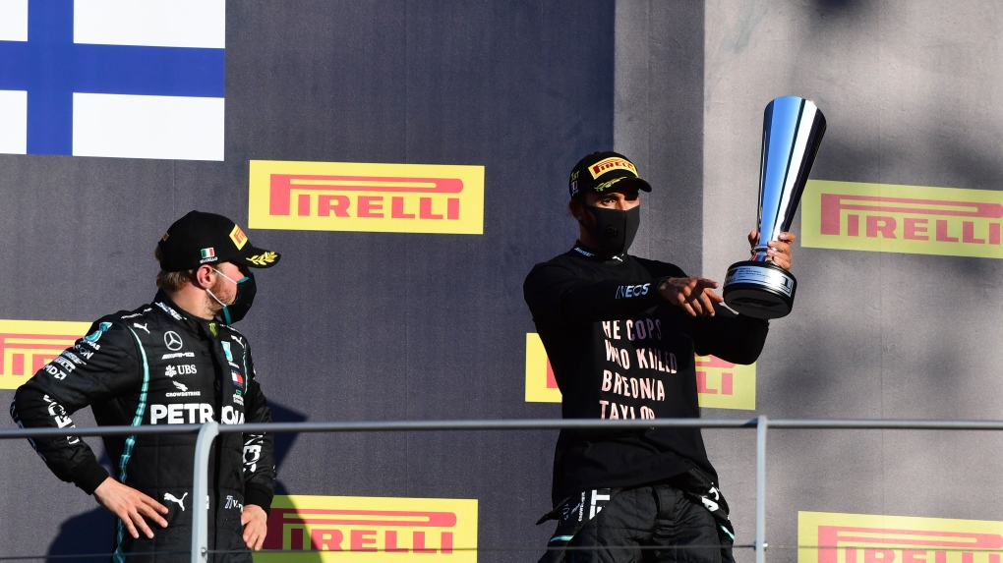
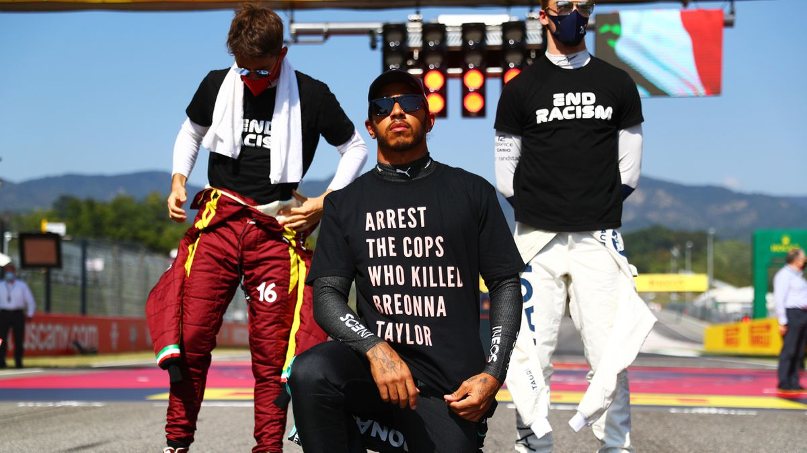
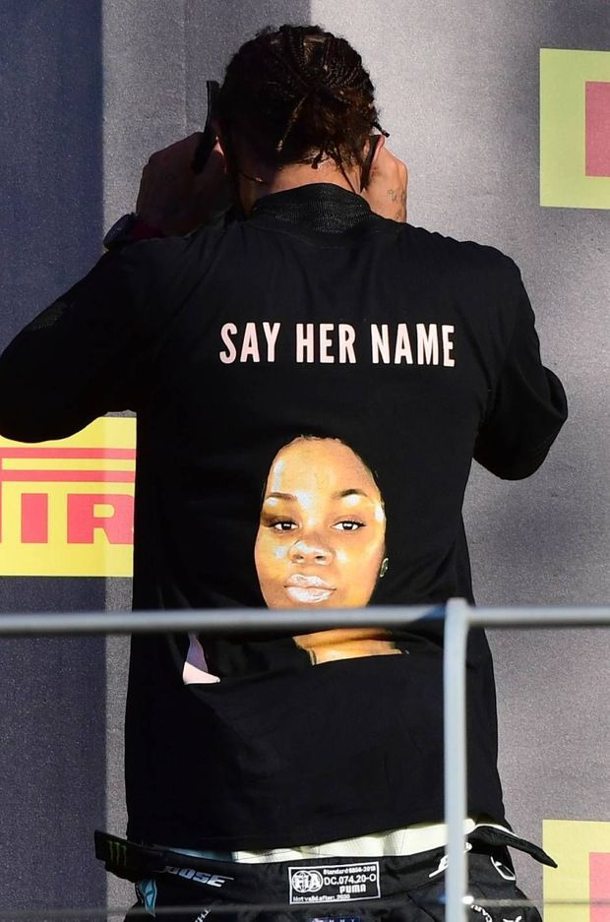
Support to Breonna Taylor

Slide 7
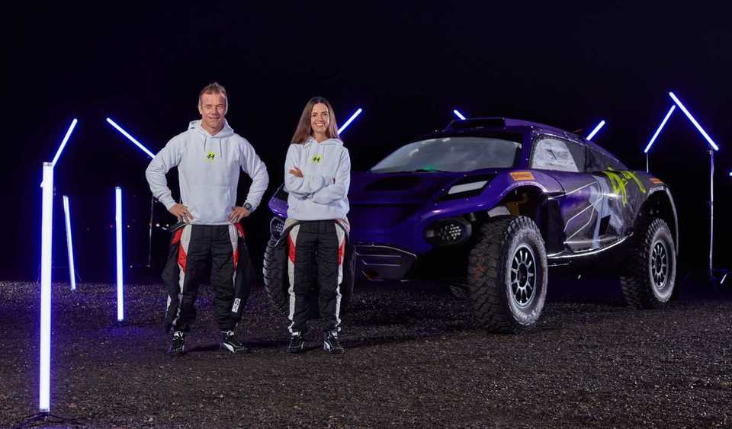
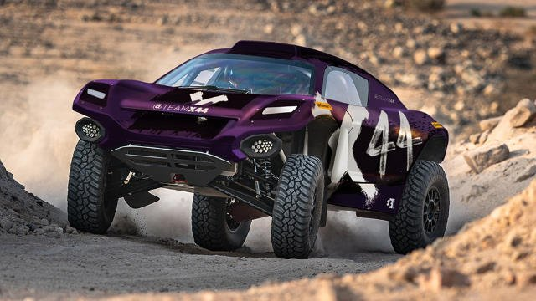
EXTREME E

Slide 8
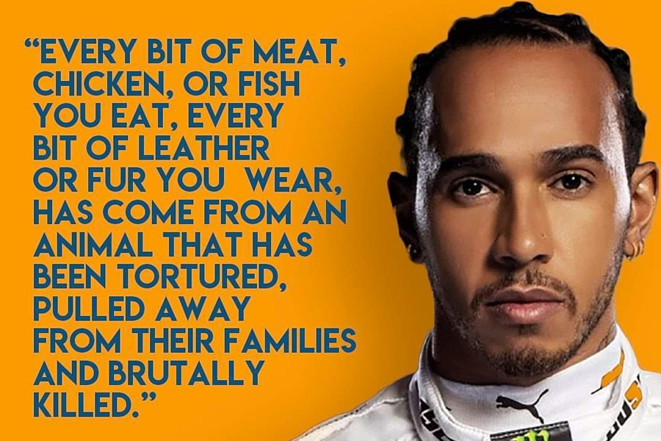
Vegan for 6 years

Slide 9
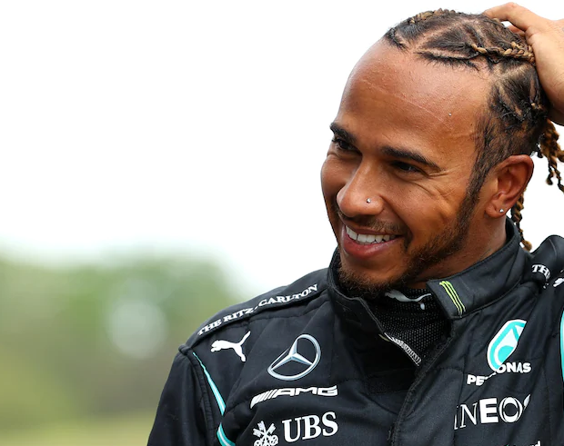
IN CONCLUSION
Outstanding F1 pilote
Involved in several important causes

Slide 10
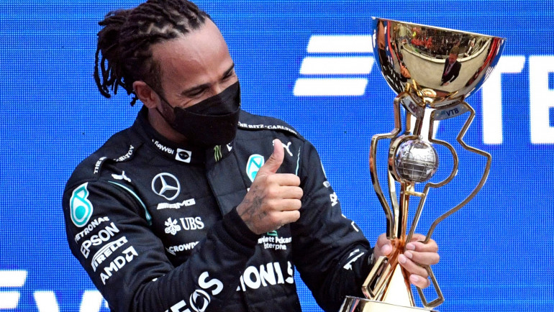
THANKS FOR YOUR LISTENING

